Slide 1
Single category classification
What we have:
Item to be classified, made up of attributes (dimensions) with values.
Patient with a disease <eyes:cloudy, muscles:weak, skin:blotchy>
Set of other items whose classification is known, also made up of attributes (dimensions) with values.
Other patients with known diseases:
<eyes:cloudy, muscles:weak, skin:pallid > Disease A
<eyes:cloudy, muscles:twitchy, skin:blotchy > Disease A
<eyes:dry, muscles:weak, skin:blotchy > Disease A
<eyes:watery, muscles:weak, skin: pallid > Disease B
<eyes: dry, muscles: taut, skin:damp > Disease B
We want to compute new item’s degree of membership in category.
(Sometimes it’s easier to view this attribute: value pairs abstractly, rather than in terms of concrete values.)
<D1:A, D2:A D3:B >
<D1:A, D2:B D3:A >
<D1:B, D2:A D3:A >
<D1:C, D2:A D3:B >
<D1:B, D2:C D3:C >

Slide 2
Cognitive modelling project
In this project you will be given experimental results on people’s classification of a range of items in three different categories.
Your task is to produce a cognitive model of the classification of these items in these categories.

Slide 3
Two theories
Prototype theory.
Each category has a prototype (a summary representation of its members). A new item to be classified is compared to all prototypes. The one to which it is most similar is the item’s membership category.
Exemplar-based theory.
When classifying an item in a category, we compare it to all previous members of all categories. The category to which the item has the highest summed membership is the item’s membership category.
Computational modelling:
How a prototype is formed?
How similarity is computed?
what parameters are used?

Slide 4
Additive weighted-attribute prototype model
The prototype for a given category consists of a list, for each dimension available, of all possible values on that dimension. Values are weighted to show their relative importance for the category. The weight for any given value A on a dimension D for category C is
Number of occurrences of <D:A> in stored members of C
W(<D:A>,C) =
Total number of occurrences of <D:A> across all categories
The more often an attribute occurs in category C, the higher its weight will be in the prototype for that category and hence the more important it will be in that category.
When classifying an item in a category, add the weights of that item’s attributes in that category’s prototype. The higher the total score, the better the item is as a member of that category.

Slide 5
Additive weighted prototype example
Set of category items:
< D1:A, D2:A, D3:B > Disease A
< D1:A, D2:B, D3:A > Disease A
< D1:B, D2:A, D3:A > Disease A
< D1:C, D2:A, D3:B > Disease B
< D1:B, D2:C, D3:C > Disease B
Prototype for category A:
D1
A2/2=1.0
B1/2=0.5
C0/1=0.0
D2
A2/3=0.67
B1/1=1.0
C0/1=0.0
D3
A2/2=1.0
B1/2= 0.5
C0/1 =0.0
Computing prototype weightings
Classifying new items in A:
Adding weights of new item’s attribute values
<D1:C,D2:A,D3:B>
= 0.0 + 0.67 + 0.5
= 1.17
<D1:A,D2:A,D3:B>
= 1.0 + 0.67 + 0.5
= 2.17
<D1:A,D2:B,D3:A>
= 1.0 + 1.0 + 1.0
= 3.0

Slide 6
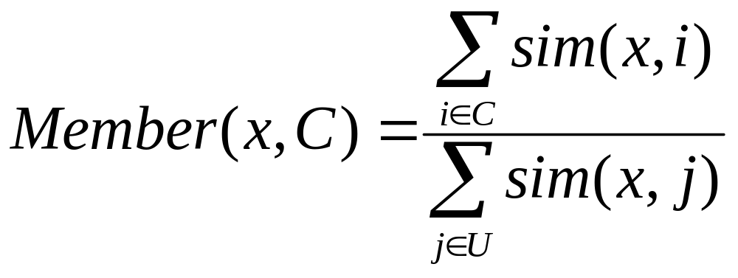
An exemplar model: context theory
When classifying an item in a category C, its degree of membership is equal to the sum of its similarity to all examples of that category, divided by its summed similarity to all examples of all categories.
U is the set of all examples of all categories
How is the similarity between two items (e.g. sim(x,i) ) computed?
The exemplar model uses a multiplicative similarity computation: compare the item’s values on each dimension. If the values on a given dimension are the same, mark a 1 for that dimension. If the values on a given dimension are different, mark a parameter s (e.g. 0.2) for that dimension. Multiply the marked values for all dimensions to compute the overall similarity of the two items.

Slide 7
Context theory example
Set of category items:
< D1:A, D2:A, D3:B > Disease A
< D1:A, D2:B, D3:A > Disease A
< D1:B, D2:A, D3:A > Disease A
< D1:C, D2:A, D3:B > Disease B
< D1:B, D2:C, D3:C > Disease B
We can pick whatever value we like for these parameters: we pick the ones that give the best fit to the data.
Classifying new item <D1:C,D2:A,D3:B> in A:
S₃=0.5
S₁=0.2
S₂=0.3
<D1:C,D2:A,D3:B>
<D1:A, D2:A, D3:B>
= 0.2 * 1.0 * 1.0
= 0.20
< C, A, B>
< A, B, A>
= 0.2 * 0.5 * 0.3
= 0.03
< C, A, B>
< B, A, A>
= 0.2 * 1.0 * 0.3
= 0.06
< C, A, B>
< C, A, B>
= 1.0 * 1.0 * 1.0
= 1.00
< C, A, B>
< B, C, C>
= 0.2 * 0.5 * 1.0
= 0.10
0.20+0.03+0.06
Membership(<CAB>,A) =
= 0.21
0.20+0.03+0.06+1.00+0.10

Slide 8
Your cognitive modelling work
You can do cognitive modelling using the additive-prototype or exemplar-based models or ANY OTHER APPROACH YOU LIKE.
If you can come up with your own approach, that would be great!
You will model the results of an experiment on how people classified artificial items (described on three dimensions) in 3 previously-learned artificial categories.
First you will model classification in single categories. Later you will model classification in conjunctions of those categories.
The data to be used in your modelling work is available in an excel spreadsheet here
Try “introduction to excel” in Google if you haven’t used the excel spreadsheet before.

Slide 9
Overview of experiment
Method: Investigates classification and overextension (logical errors) using a controlled set of patient-descriptions (items), symptoms (features on 3 dimensions) and categories (diseases A, B, and C).
Training phase: 18 participants get a set of patient descriptions (training items) with certain diseases and symptoms, and learn to identify diseases (to criterion).
Test phase: Participants get 5 new patient descriptions (test items) with new symptom combinations. For each test item participants separately rate patient as having disease A, B, C, A&B, A&C, B&C. Each test item therefore occurs 6 times in the test phase (with 6 different rating questions).
Results. Classification scores and frequency of overextension errors.

Slide 10
Training items
These disease categories have a family-resemblance structure: there are no simple rules linking an item’s symptoms and category membership.
Participants learned categories by studying items like these. Different participants got different symptom-words in the training materials, but all had the same symptom distribution.
Participants then classifed new “test” items in categories and category conjunctions.
Item Symptoms Category
EYES SKIN MUSCLES
1 | Puffy | Flaking | Strained | Disease A
2 | Sunken | Flaking | Knotty | Disease A
3 | Sunken | Pallid | Knotty | Disease A
4 | Puffy | Sweaty | Knotty | Disease A
5 | Puffy | Flaking | Limp | Diseases A&B
6 | Puffy | Blotchy | Twitchy | Diseases A&B
7 | Red | Flaking | Knotty | Disease B
8 | Cloudy | Blotchy | Twitchy | Disease B
9 | Red | Blotchy | Twitchy | Disease B
10 | Red | Jaundiced | Knotty | Disease B
11 | Red | Pallid | Twitchy | Disease B
12 | Red | Jaundiced | Weak | Disease C
13 | Sunken | Jaundiced | Twitchy | Disease C
14 | Red | Flaking | Weak | Disease C
15 | Sunken | Flaking | Twitchy | Disease C
16 | Sunken | Jaundiced | Weak | Disease C
17 | Cloudy | Jaundiced | Twitchy | Disease C

Slide 11
Test items
Symptoms rated as member of category or conjunction
 | EYES | SKIN | MUSCLES |  | A | B | C | A&B | A&C | B&C
1 | Puffy | Jaundiced | Weak |  | ? | ? | ? | ? | ? | ?
2 | Sunken | Flaking | Weak |  | ? | ? | ? | ? | ? | ?
3 | Red | Jaundiced | Twitchy |  | ? | ? | ? | ? | ? | ?
4 | Red | Blotchy | Weak |  | ? | ? | ? | ? | ? | ?
5 | Puffy | Blotchy | Knotty |  | ? | ? | ? | ? | ? | ?
Participants learned training items and then classified the test items as members or non-members of the categories and conjunctions.
Your cognitive model will be given the training items and use the feature distribution there to compute the degree of membership for each test item in each category, and later in each conjunction. This degree of membership will be compared with the observed average degree of membership in the experiment.

